Slide 1
Key points about atmosphere models
Brian Mapes
October 2021
ATM407

Slide 2
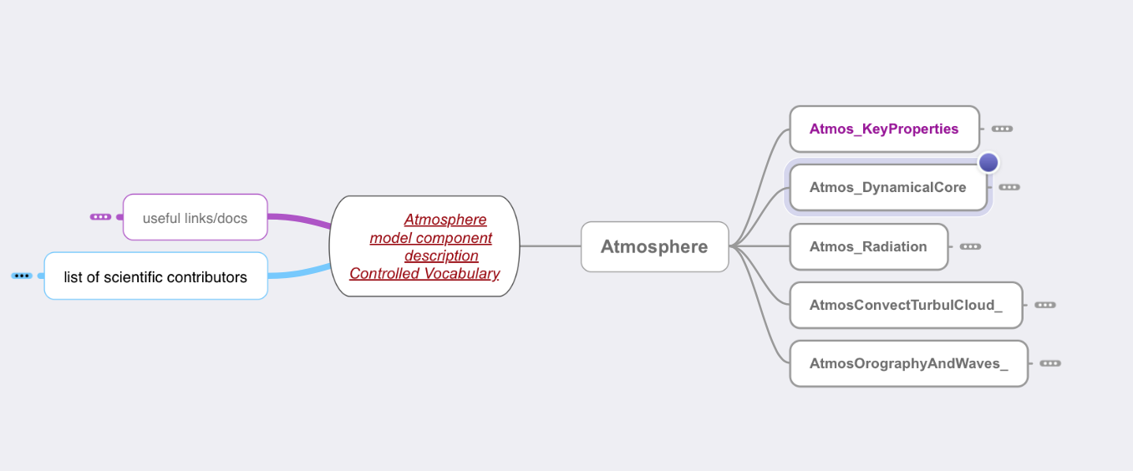
Controlled Vocabularies: atmosphere_bdl.mm http://proj.badc.rl.ac.uk/pimms/browser/CASCADE/ControlledVocabs/trunk/Software?rev=48&order=size Paper about it: https://gmd.copernicus.org/articles/7/479/2014/gmd-7-479-2014.pdf View in FreeMind http://freemind.sourceforge.net/wiki/index.php/Download or MindNode
Notes:
http://proj.badc.rl.ac.uk/pimms/browser/CASCADE/ControlledVocabs/trunk/Software?rev=48&order=size

Slide 3
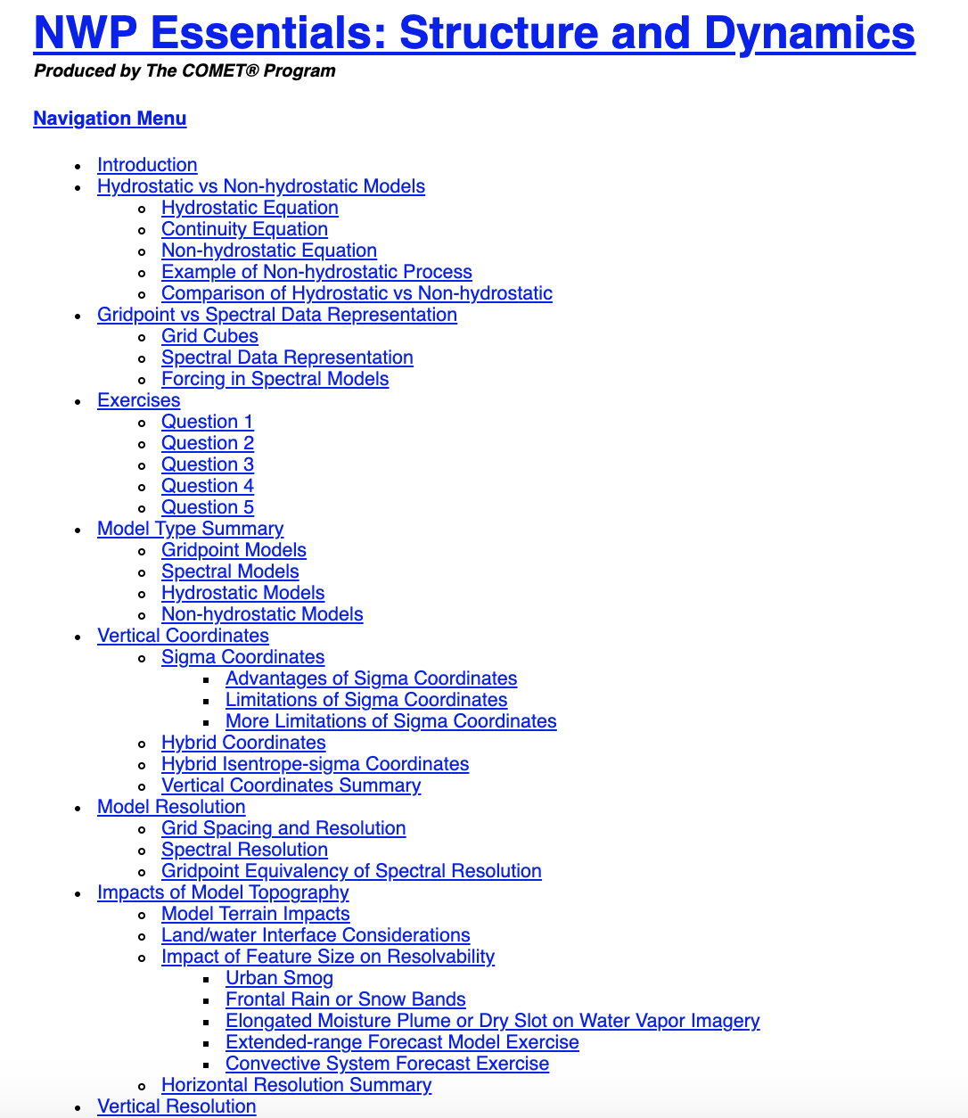
Key issues in models Numerics
Hydrostatic vs. non-
Gridpoint vs. spectral
Vertical coordinates
terrain-following (sigma)
isentropic (resolves inversions)
pressure; or hybrid (p away from sfc)
Horizontal resolution
about 3 (π) gridpoints per spectral wave
Vertical resolution
phenomena: PBL, melting level, tropopause
https://www.meted.ucar.edu/bom/mstructure_dynamics/print.php
Notes:
https://www.meted.ucar.edu/bom/mstructure_dynamics/print.php

Slide 4
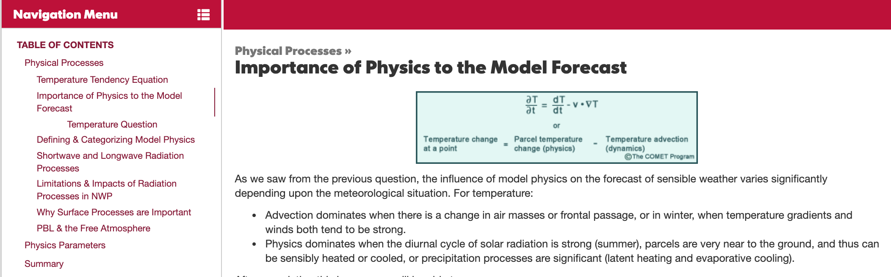
Key issues in models Physics

Slide 5
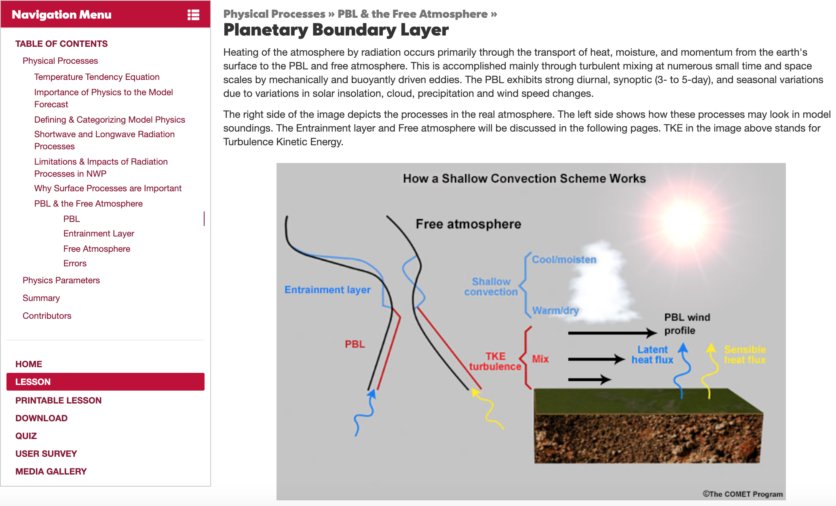
One physical process scheme: PBL processes

Slide 6
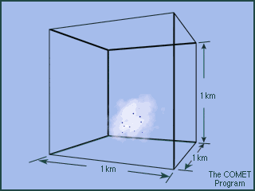
Cloud in a gridbox animation

Slide 7
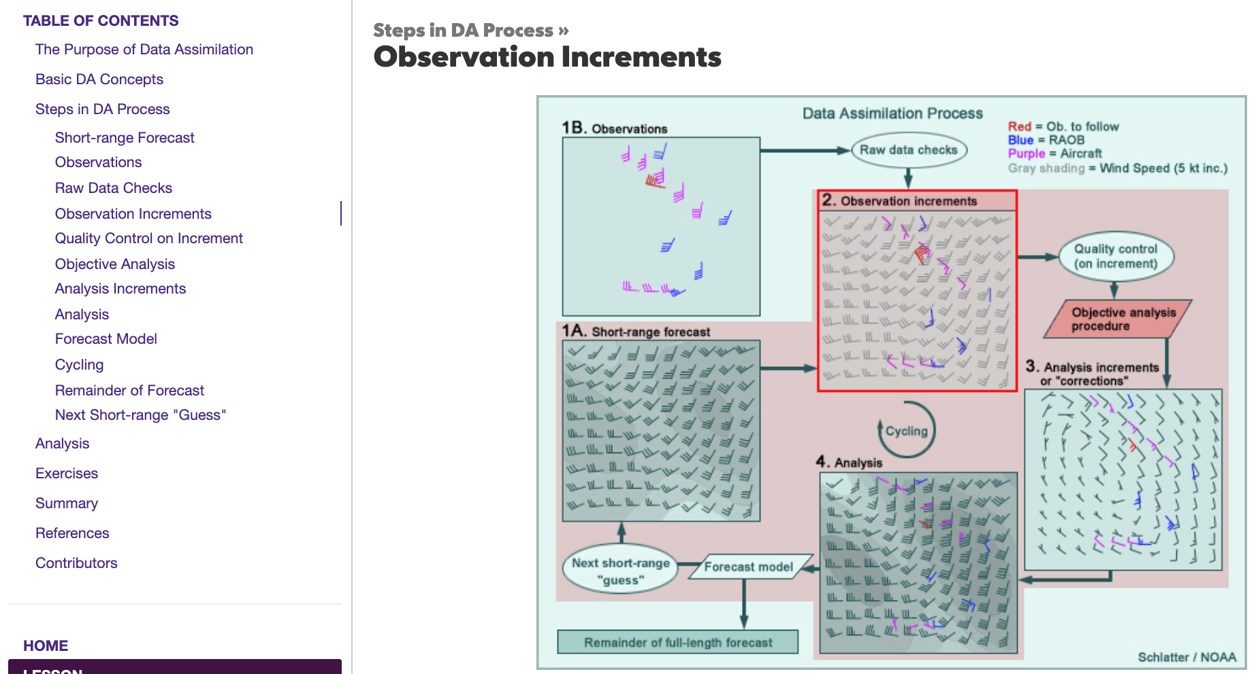
Assimilation

Slide 8
Data Assimilation (DA): key concepts
short-term forecast (“first guess”): on model grid
observations (at points; maybe remap onto model gridpoints)
quality control, and relative weights (trust) in o-f difference
issues: accuracy, locality incl. timing, representativeness
“analysis” – a compromise (weight by relative trustedness)
analysis increment a-f is the model field adjustment (impact of obs)
o-a should be smaller than o-f (model state is “drawn toward” obs)
cycling → reanalysis
turn off DA → forecast (hindcast or reforecast if for a past case)
long past skill, or no DA → “simulation”

Slide 9
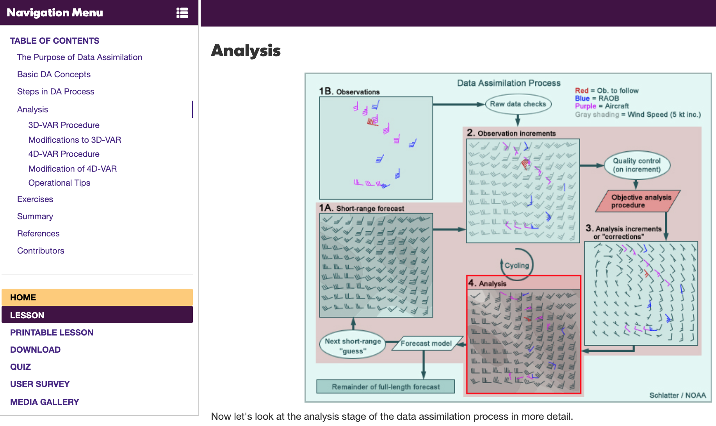
All that was 3D. 4D sort of “adjusts observation location” to where it was at analysis time

Slide 10
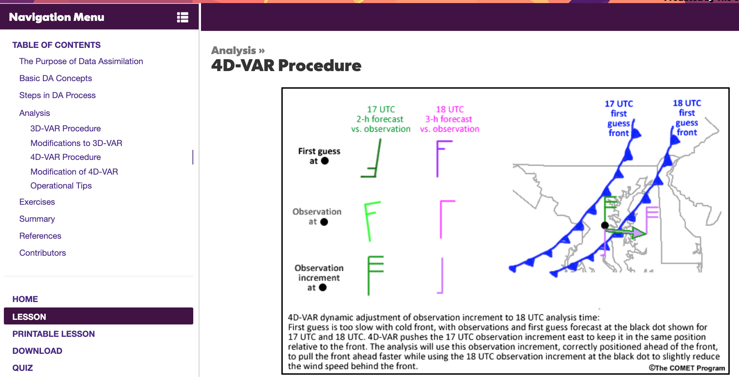
4D-VAR concept in Data Assimilation

Slide 11
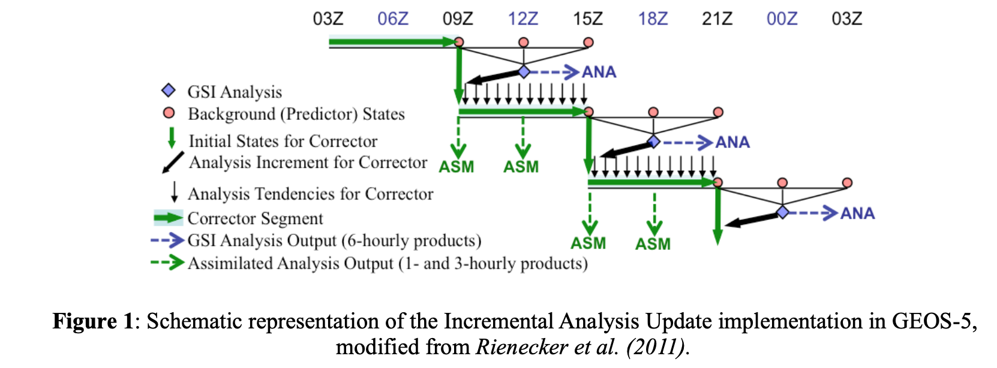
MERRA IAU concepts: from ANA to ASM products

Slide 12
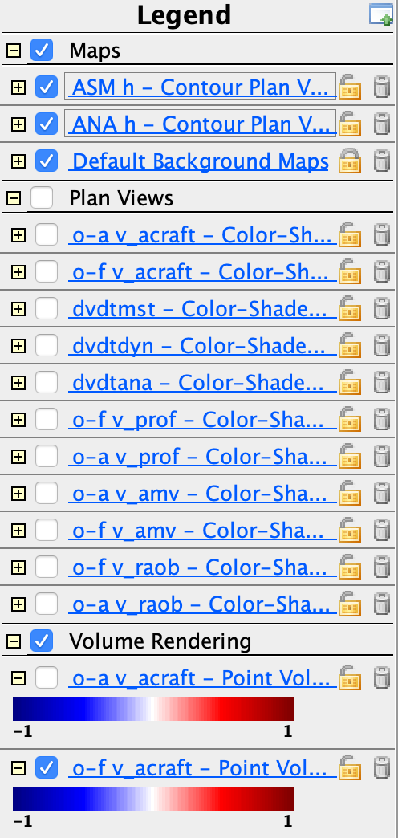
Data exercise with MERRA reanalysis system
Key concepts:
o-f for various obs systems
o-a should be closer to 0 on average, right?
ANA: the analysis state (every 6 hours)
ASM: the “assimilated” state (output every 3h or even 1h)
obtained by integrating ddt = ddt_dyn + ddt_phy + ddt_ana
for every model field (u,v,T,q,etc.)
ddt_ana is constant for 6 hours
designed to steer the model through ANA state

Slide 13
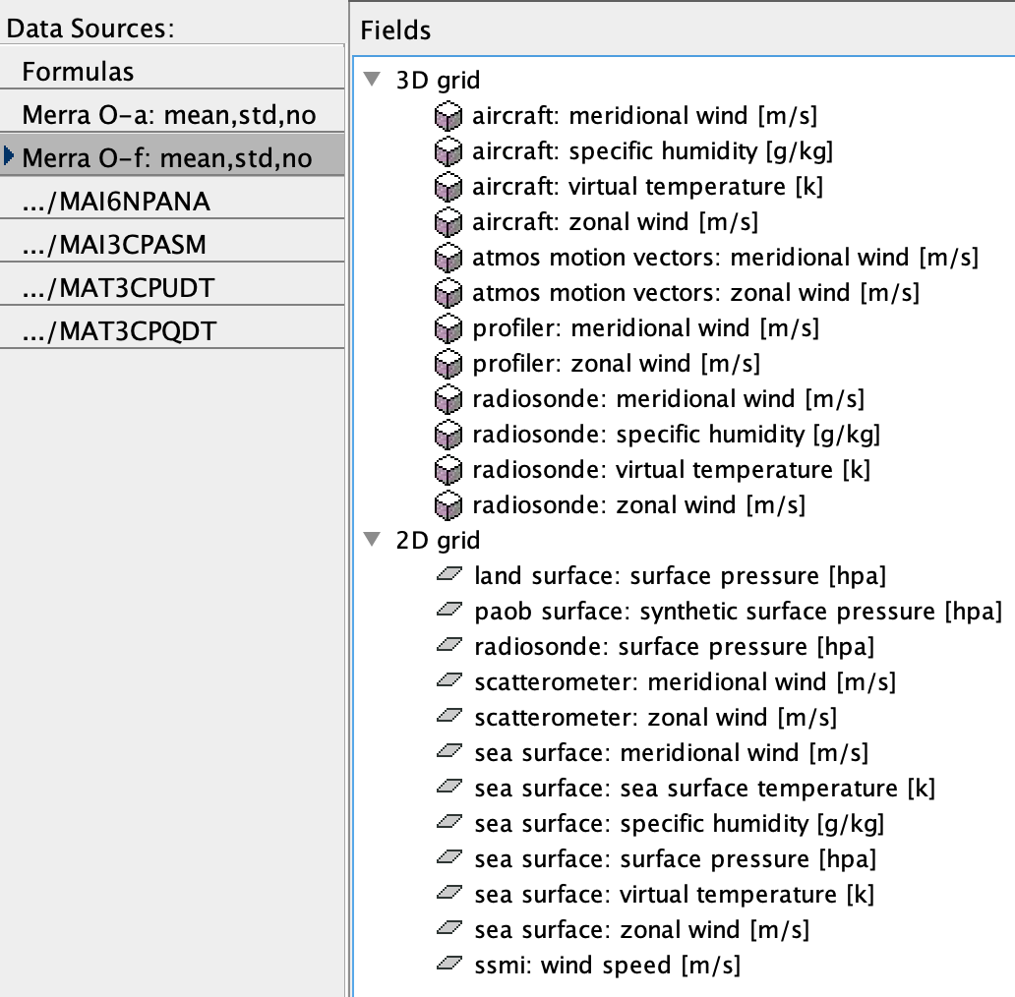
o-f, o-a fields available:

Slide 14
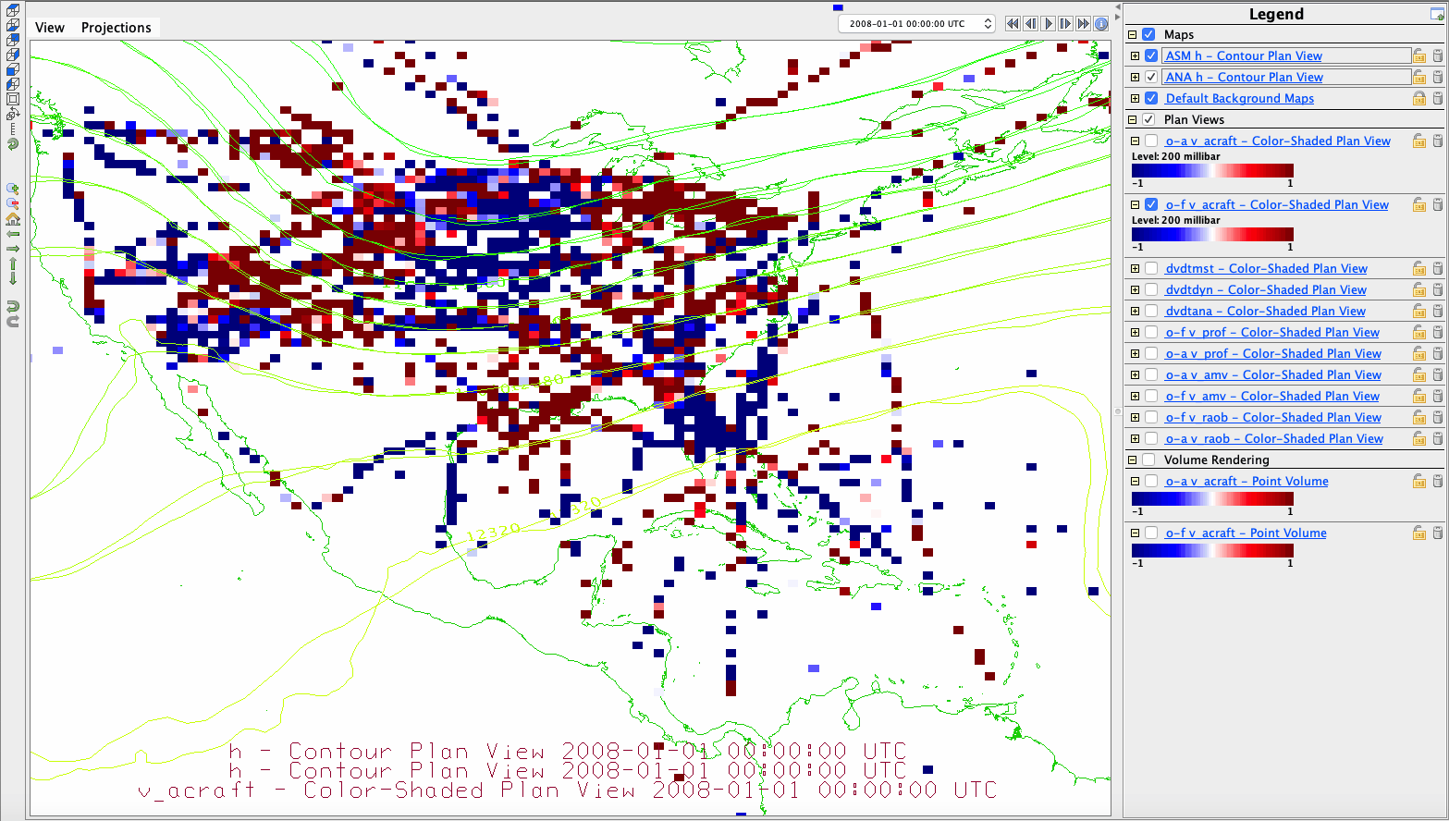




o-f and o-a. Hopefully the latter is ”smaller on average”, or at least “more random” (less systematic), since the analysis has been “drawn toward” the large-scale aspects of the observations
similarly, all blue here
becomes speckle
All red here in o-f
(obs have stronger southerlies
than first guess forecast f), but then
the analysis has only random errors
(equal red and blue speckles).

Slide 15
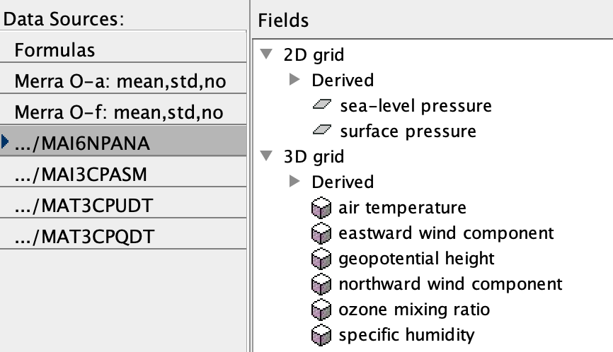
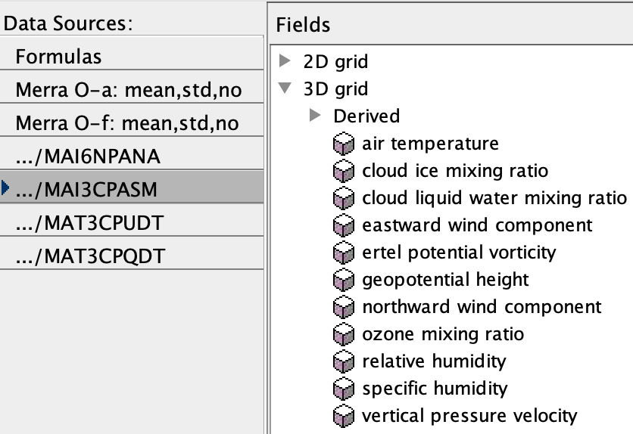
ANA vs. ASM
6-hourly ANA
hor. winds only
3-hourly ASM
has vertical vel., clouds, etc.

Slide 16
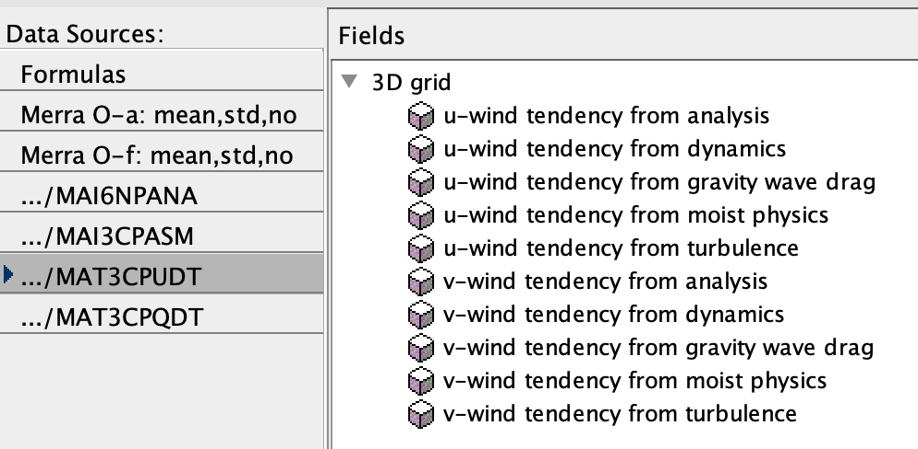
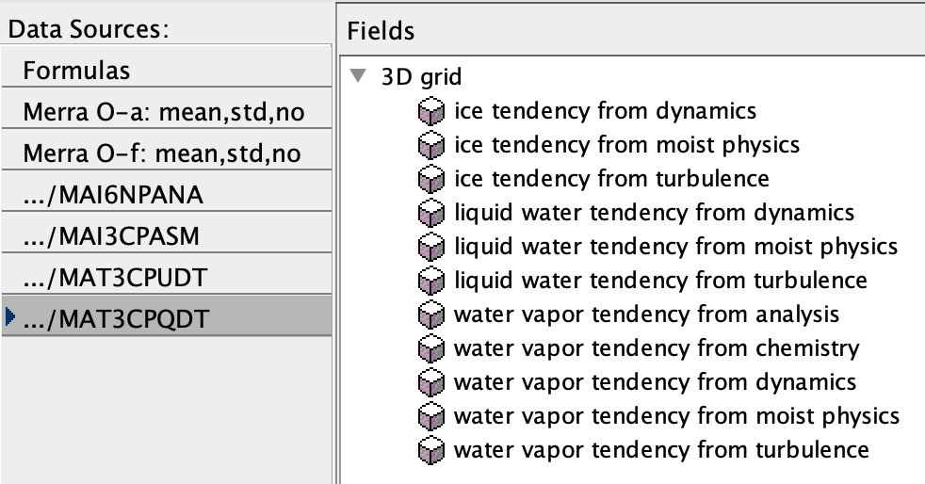
Budgets of wind, q
does moist physics affect wind?
YES: low-level momentum carried upward in convection!

Slide 17
ASSIGNMENT: Pick a different date, capture basic set of displays, think about them. Present to class about their meaning. v200 is a good target field
1. Launch IDV. Set up authentication.
In the Dashboard - Data Choosers tab, General->URLs slot, paste dods://goldsmr3.gesdisc.eosdis.nasa.gov/dods/MAT3CPQDT and click Add Source. It should ask for authentication. Check the Save Information box, and carefully enter mapes, MapesIDV0 for name and password. Does it come up as a data source?
2. Now load this bundle: MapesIDV/Classes and Labs/MERRA_o-f_o-a_and_vbudget200.
3. Change the date to anytime between 1980 and 2008, going for a 12Z or 00Z (or see how much data there is at a 06Z or 18Z), and/or region (Europe, Asia).

Slide 18
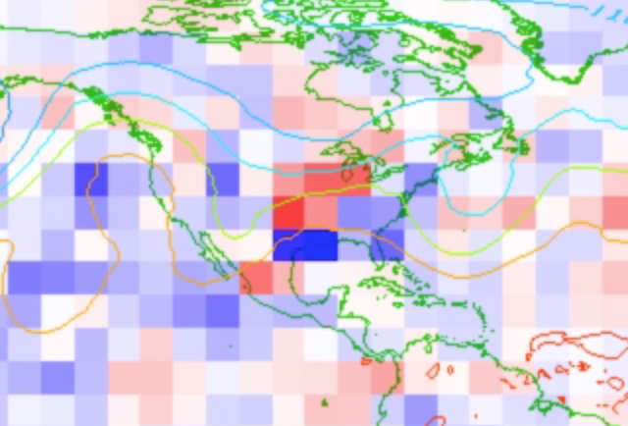
https://www.spc.noaa.gov/climo/reports/080514_rpts.html
v budget during MERRA reanalysis and assimilation process
Case with severe weather, lots of o-f difference and big dvdt_ana
https://nbviewer.org/github/ATMOcanes/ATM651_2021/blob/master/Files_unsorted/Assimilation_MERRAv200_20080514-16.ipynb

Slide 19
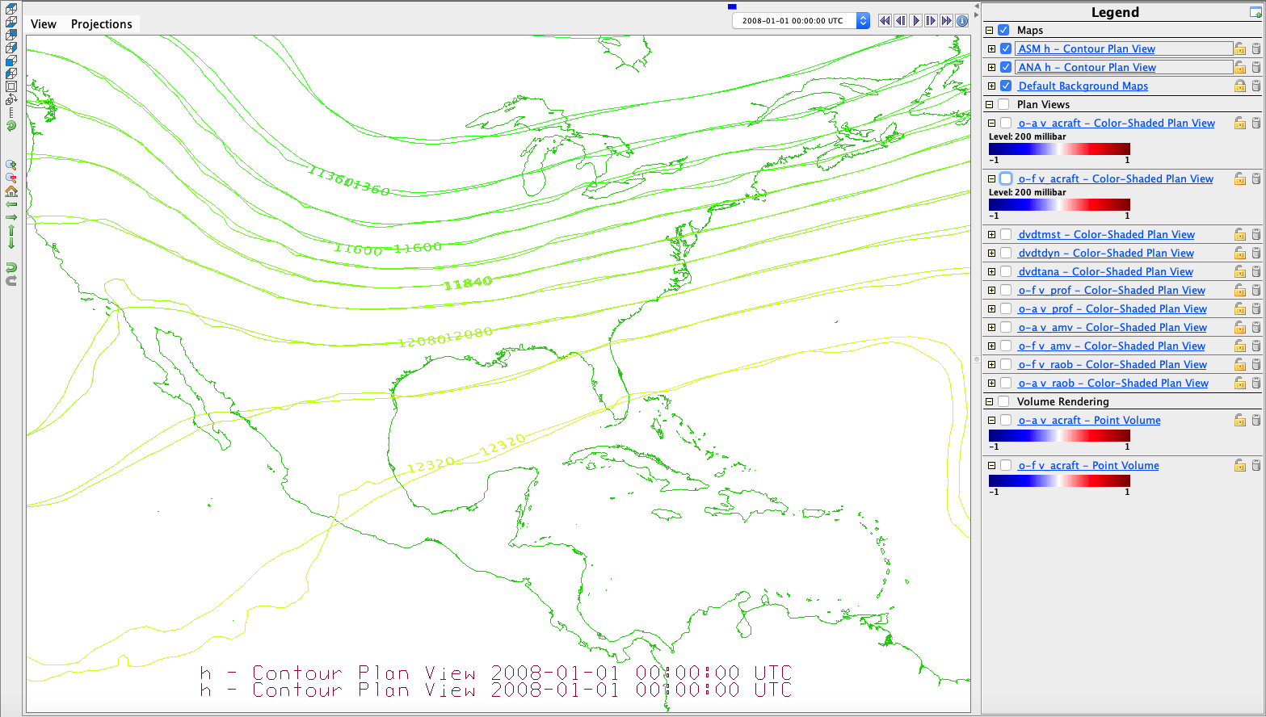

o-f and o-a. Hopefully the latter is ”smaller on average”, or at least “more random” (less systematic), since the analysis has been “drawn toward” the large-scale aspects of the observations
similarly, all blue here
becomes speckle
←NET EFFECT: OBS ARE TELLING US THE FORECAST TROUGH WAS TOO STRONG
All red here in o-f
(obs have stronger southerlies
than first guess forecast f), but then
the analysis has only random errors
(equal red and blue speckles).

Slide 20
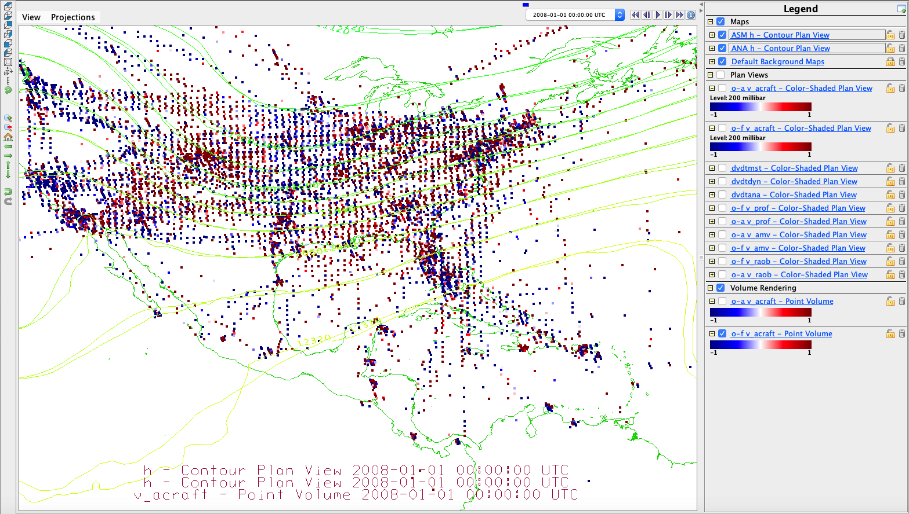
Similar o-f at all levels (this is aircraft obs, rocked off vertical so you can see the ascents/descents – mainly from Denver it seems). Might it be a mountain effect? Or just this particular northerly wind?
similarly, all blue here
becomes speckle
All red here in o-f
(obs have stronger southerlies
than first guess forecast f), but then
the analysis has only random errors
(equal red and blue speckles).

Slide 21
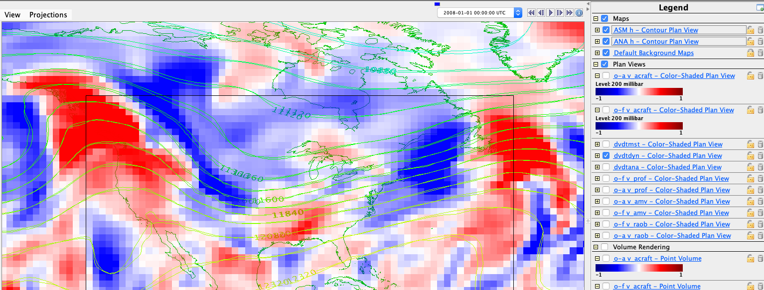
dvdt_dyn acts to propagate troughs and ridges eastward
probably mostly -u dv/dx

Slide 22
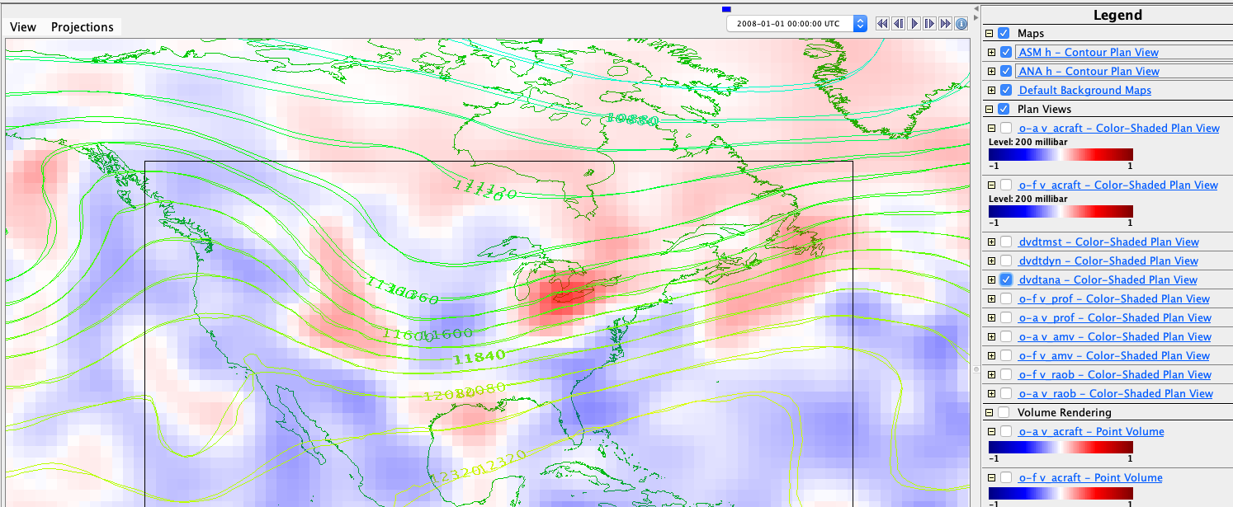
dvdt_ana is much weaker, spotty (same color range)

Slide 23
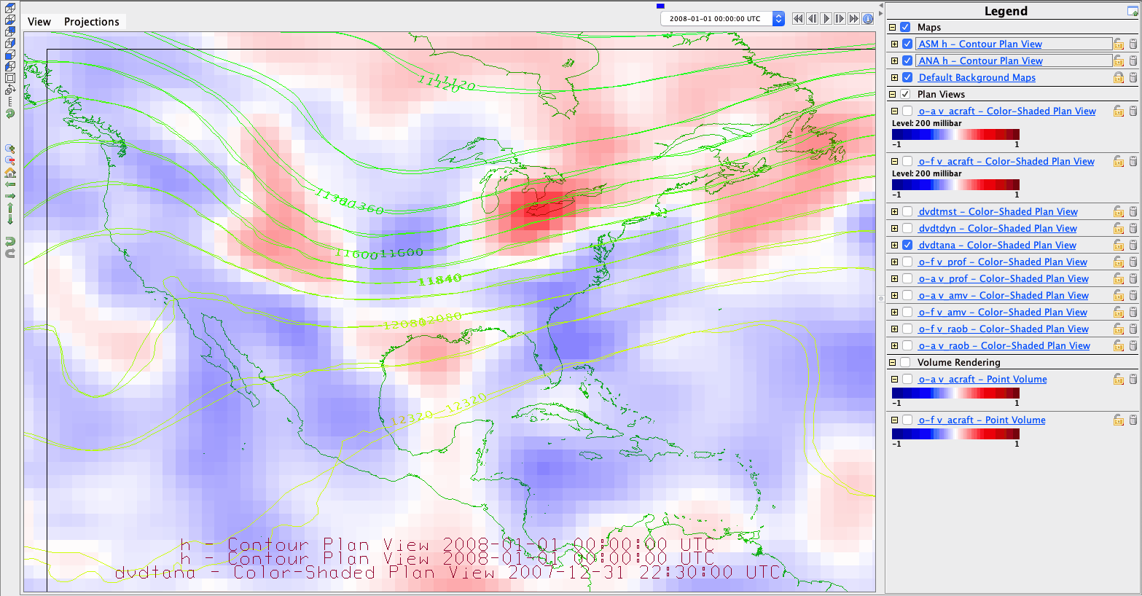
dvdt_ana pattern is similar to o-f (all obs!)
Both are indications of how observations are criticizing the model (and pushing it toward the observed state)

Slide 24
MERRA budgets and data resources:

